Slide 1
BizAI.
BIZAI LEADERSHIP LITERACY FRAMEWORK
FROM AI USE TO AI CAPABILITY
Six Leadership Shifts for Responsible AI Adoption in Small and Midsized Businesses
A practical framework for developing AI literacy in yourself, your leadership team and the people you lead.
TOOL USE → INFORMED JUDGMENT → RESPONSIBLE BUSINESS CAPABILITY
01
TOOL-FIRST THINKING → CONTEXTUAL FIT
04
SOLUTION SHOPPING → BUSINESS INQUIRY
AI Capability Is Contextual
AI Adoption Begins as Inquiry
AI’s suitability depends on the task, available information, required accuracy, consequences and operating environment.
Responsible adoption begins with business friction, purposeful questions and a measurable hypothesis—not pressure to purchase or automate.
Appropriate for what—and under what conditions?
AI LITERACY
What problem are we actually trying to solve?
02
ACCEPTING ANSWERS → EVALUATING OUTPUTS
The ability to:
05
DELEGATING WORK → PRESERVING ACCOUNTABILITY
AI Output Is Constructed,
Not Automatically Verified
UNDERSTAND
capabilities and limits
Human Accountability Cannot Be Delegated
AI output is shaped by the model, available information, instructions and context. Polished language does not establish accuracy or verification.
QUESTION
outputs and assumptions
AI may assist, prepare, compare or recommend. Responsibility for consequential decisions remains with people and the organization.
What shaped this output, and how will we verify it?
EVALUATE
fit and consequence
Who owns the final decision and its consequences?
APPLY
AI purposefully
03
CONVENIENT ACCESS → RESPONSIBLE STEWARDSHIP
GOVERN
how it is used
06
UNCONTROLLED TRIALS → STRUCTURED LEARNING
Organizational Information Has Value
IN CONTEXT
AI Capability Develops Through Strategic Experimentation
Customer data, employee knowledge, pricing, contracts, processes and intellectual property are assets requiring thoughtful stewardship.
Context turns tool use into judgment.
Sustainable adoption requires bounded tests, review, measurement, learning and deliberate decisions about whether to stop, revise or scale.
What information are we providing, and are we authorized to use it this way?
What is the smallest responsible experiment from which we can learn?
Six shifts. One leadership discipline: ask better questions before AI becomes business practice.
Turn the page to assess your current practices and identify one 30-day leadership action.
BizAI Leadership Literacy Framework | Version 1.2 | September 2026
grassrootech.com/bizai
The BizAI Leadership Literacy Framework is informed by the threshold-concept approach of the Association of College and Research Libraries’ Framework for Information Literacy for Higher Education and aligned with recognized principles of responsible AI adoption.
Notes:
Internal change note / quality-control summary:
Concept 02 revised from ‘Not Discovered’ to ‘Not Automatically Verified’ following cofounder review. The change reduces ambiguity and clarifies that AI-generated output requires evaluation before it is treated as verified or authoritative.

Slide 2
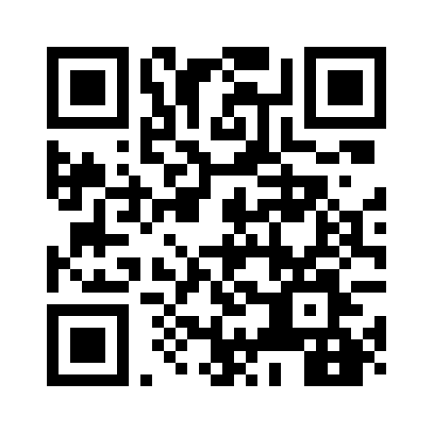
BizAI.
FROM LITERACY TO PRACTICE
Leaders do not need to perform every AI-enabled task. They need enough literacy to establish expectations, ask informed questions and remain accountable for how AI affects the business.
REVIEW → ASSESS → ACT
Review what leaders establish and teams practice. Assess current consistency. Select one action for the next 30 days.
WHAT LEADERS ESTABLISH → WHAT TEAMS PRACTICE
LITERACY CONCEPT
THE LEADER ESTABLISHES
THE TEAM PRACTICES
AI Capability Is Contextual
Approved uses, limitations and risk boundaries
Selects AI according to the task and potential consequence
AI Output Is Constructed,
Not Automatically Verified
Verification expectations and review standards
Separates drafts and suggestions from verified facts
Organizational Information Has Value
Clear rules for confidential and proprietary information
Knows what may and may not be entered into AI systems
AI Adoption Begins as Inquiry
Business priorities, problem definitions and success measures
Starts with process friction—not a preferred tool
Human Accountability Cannot Be Delegated
Named owners for decisions and consequential outputs
Reviews work before it affects customers, employees or operations
AI Capability Develops Through Strategic Experimentation
Bounded tests, measures and formal review points
Records results, limitations and lessons learned
These six leadership shifts provide a foundation for the 12-month BizAI journey from understanding AI to building measurable business capability.
60-SECOND LEADERSHIP CHECK
Use this to identify your next development need—not to grade the organization.
Choose the current state—not the desired state.
1. We can explain where AI is and is not appropriate in our business.
NOT YET
INCONSISTENTLY
CONSISTENTLY
2. We verify consequential AI-generated information before acting.
3. Employees understand what information may enter an AI system.
4. AI initiatives begin with a defined business problem.
5. Every AI-supported workflow has a responsible human owner.
6. Experiments have boundaries, measures and a review point.
NEXT 30 DAYS
Our most important AI-literacy gap:
One leadership action we can take:
One team practice we should establish:
Evidence of progress within 30 days:
WHAT I UNDERSTAND → WHAT I ESTABLISH AS A LEADER → WHAT MY PEOPLE PRACTICE → WHAT OUR ORGANIZATION BECOMES CAPABLE OF DOING
CONTINUE THE CONVERSATION
BizAI Leadership Literacy Framework | Version 1.2 | September 2026
Learn more about BizAI and explore the 12-month program.
grassrootech.com/bizai
The BizAI Leadership Literacy Framework is informed by the threshold-concept approach of the Association of College and Research Libraries’ Framework for Information Literacy for Higher Education and aligned with recognized principles of responsible AI adoption.

